Slide 1
Global Tech Layoff Analysis (2020 - 2024)
Bootcamp Data Analyst with SQL & Python using Google Platform
Irfan Maulana

Slide 2
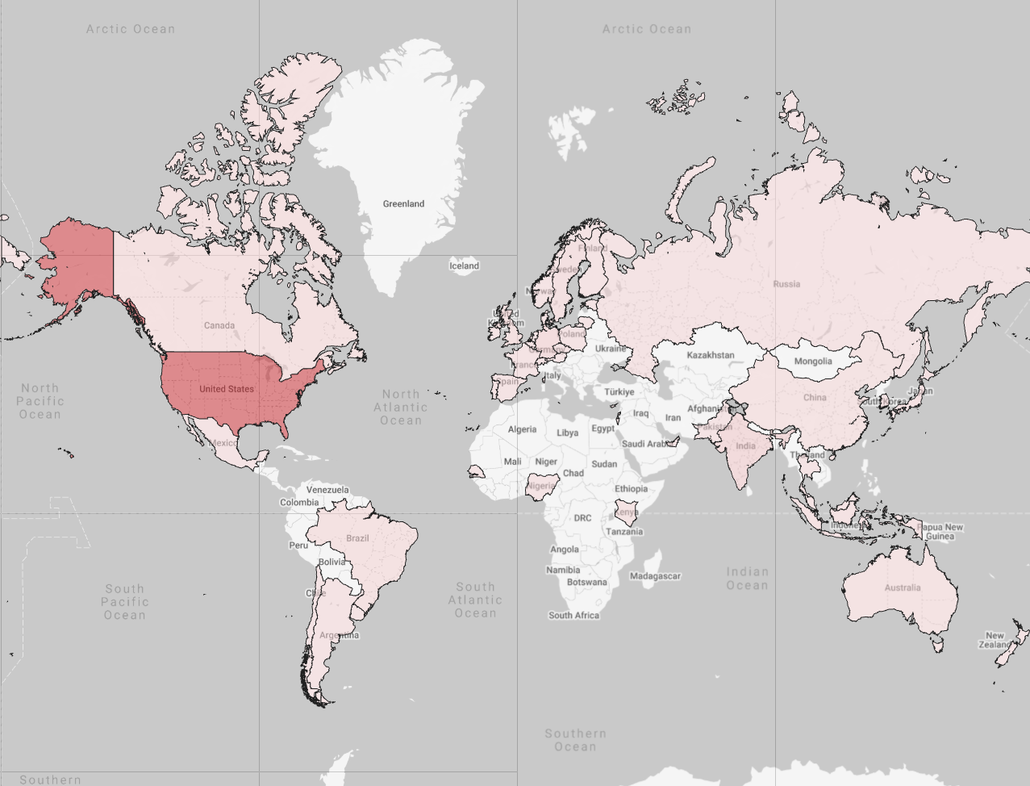
| BACKGROUND
The tech sector experienced a massive shock post-pandemic, marked by an unprecedented wave of mass layoffs.
There is significant uncertainty regarding who is most affected. Is it the giant companies (Big Tech) or small startups?
Does massive funding guarantee job security?
This analysis aims to dissect layoff patterns based on Geography, Industry, Company Stage, and Financial Health to provide insights for job seekers and investors.

Slide 3
| ABOUT DATA
Source
Coverage
Tech Layoffs Dataset (Combined from 2020 - 2025) from layoffs.fyi.
2,000+ Tech Companies recorded (after cleaning).
Covers 558,000+ affected employees.
Time range: 2020 to Q1 2025 (Forecast/Running Data).
Variables
Tools & Libraries
Demographics: Company, Location HQ, Industry, Country.
Financials: Money Raised (Mil $), Stage (IPO, Series A-J).
Impact: Laid Off Count, Percentage of Workforce Affected.
Python (Pandas, NumPy): For data cleaning, text normalization, and missing value imputation.
Looker Studio: For interactive visualization and dashboarding.

Slide 4
Data Cleaning & Preparation
Step | Action | Description
1 | Date Standardization | Converted inconsistent date formats (e.g., DD.MM.YY mixed with others) into a standard datetime format.
2 | Handling Missing Values (Imputation) | Filled empty Laid_Off values using mathematical logic: Formula: Laid_Off = Company_Size * (Percentage/100).
3 | Name & Entity Fixing | Fixed broken company name typos (Example: "SaleSan Francisco..." to "Salesforce", "Transan..." to "Transfix") Standardized Industries (Example: Merging "Transportion" into "Transportation").
4 | Location Mapping | Mapped cities to the corresponding Country/Continent and cleaned location names (e.g., removing redundant "Bay Area") for geospatial map accuracy.

Slide 5
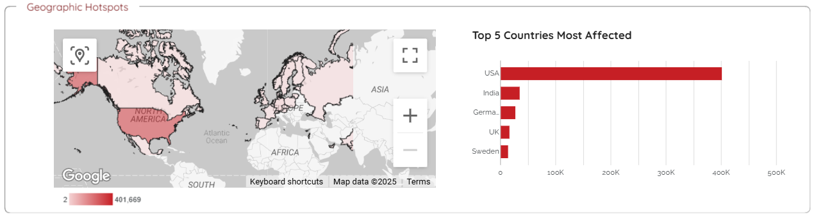
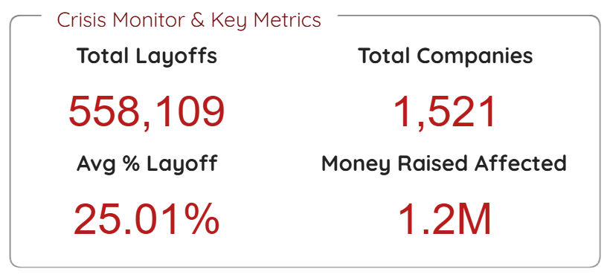
CRISIS SNAPSHOT
A total of 558,109 employees were affected by layoffs from 1,521 companies.
Not Just Efficiency, But Restructuring: The 25% figure is very high. Usually, routine efficiency cuts are only around 5-10%.
The United States is the epicenter of the layoff storm with over 400,000 cases, far surpassing India, Germany, and the UK.
The largest spike in layoffs occurred in early 2023 (Q1), indicating a massive market correction post-pandemic.

Slide 6
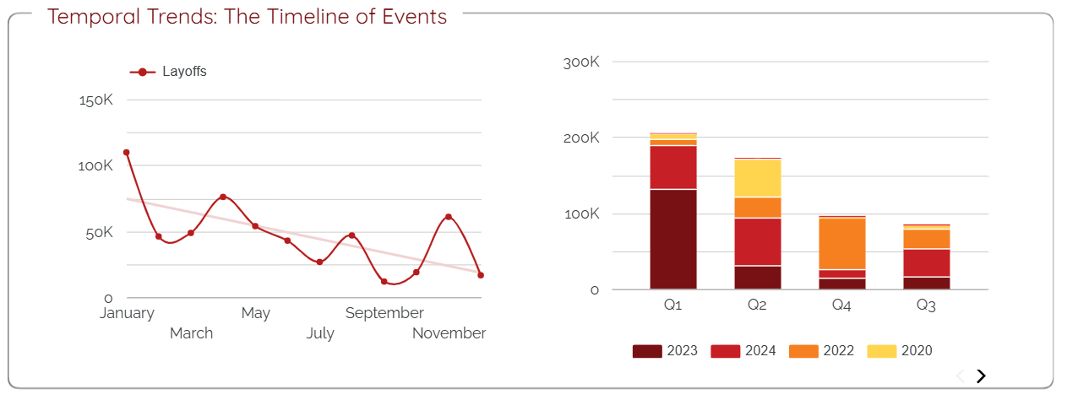
Temporal Trends
After year-end performance reviews, companies tend to let go of employees considered underperforming or close unprofitable divisions at the beginning of the year.
2023 was the year of the largest post-pandemic correction. Companies realized they had overhired during the pandemic and had to cut costs drastically due to recession fears.
Although layoffs are still happening in 2024, the volume is decreasing. This signals the market is starting to stabilize, though it is not yet completely safe (efficiency cuts still exist).

Slide 7
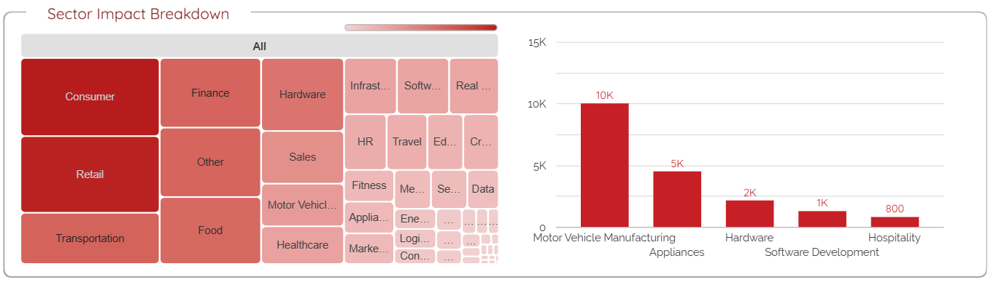
Industry & Stage Profile
The Retail, Consumer, and Transportation industries are the most affected in terms of volume (headcount). This correlates with the decline in global consumer purchasing power.
Motor Vehicle Manufacturing and Hardware industries have the highest average layoff percentage (reaching extreme figures like 60%).
The Automotive (Motor Vehicle) and Hardware sectors are the riskiest. Once layoffs happen, the impact is deep and fatal (high percentage cuts).

Slide 8
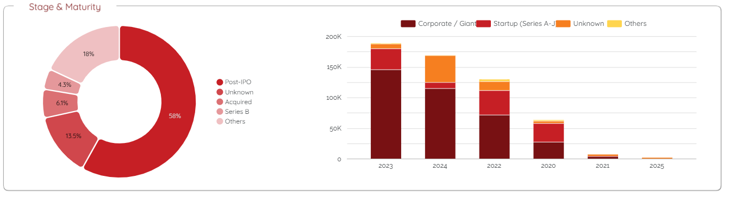
Maturity & Vulnerability: STARTUP vs. GIANTS
The Post-IPO category contributes the highest number of laid-off employees in absolute numbers (Volume) due to efficiency measures.
However, the accumulated impact from Startups (Series B, Unknown) is also massive. The difference is that Startups fire people not for efficiency, but to avoid bankruptcy.
This crisis is a double-edged sword: Giants are cutting 'fat', while Startups are cutting their own 'legs' just to survive.

Slide 9
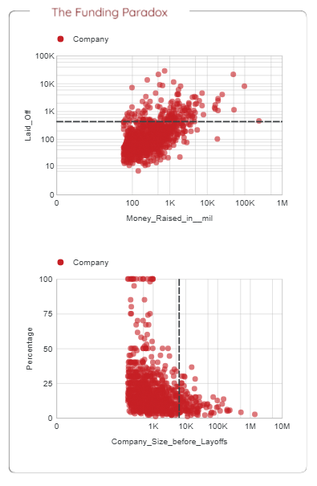
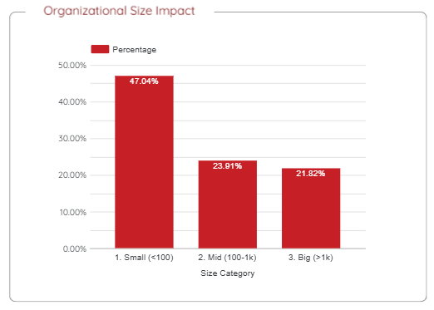
Maturity & Vulnerability: STARTUP vs. GIANTS
Money $\neq$ Safety: The Scatter Plot shows that companies with large funding (High Money Raised) are not immune to layoffs. Many companies with funding >$100M still conducted massive layoffs.
Organizational Size: Small companies (<100 employees) have the highest average layoff percentage (47.04%). They tend to cut nearly half of their workforce, which often leads to operational closure.

Slide 10
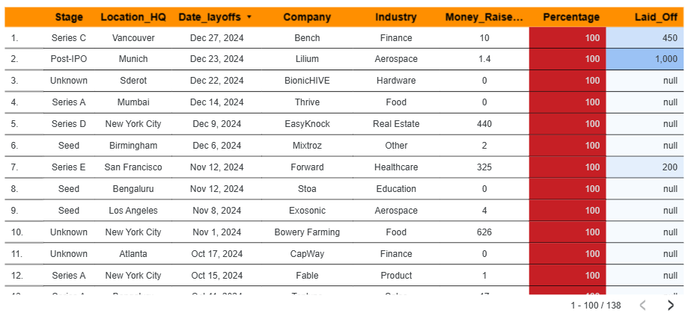
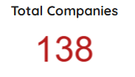
Critical Alerts
There are 138 Companies that went bankrupt or closed down (100% layoffs). This means the company ceased operations and disbanded the entire team.
Case Study: Lilium (Aerospace), a Post-IPO company, fired 100% of its employees (1,000 people).
Lesson: The Lilium case proves that even companies that have gone Public (Post-IPO) can go completely bankrupt. "Public" status does not guarantee survival if the business model is not sustainable.

Slide 11
| Conclusion & Recommendation
Conclusion
Recommendation
The tech industry has abandoned the "Growth at All Costs" mentality in favor of profitability, resulting in a massive market correction affecting 558,000+ employees.
Data proves that investor funding does not guarantee job security; cash flow health is far more crucial than total capital raised.
1. For Talent (Job Seekers):
      Choose Sector: Prioritize B2B SaaS sectors which are more stable compared to capital-intensive sectors like Hardware/EV or Retail.
      Timing: Beware of the "January Purge"; avoid risky career moves at the end of the year (Q4) without preparation.
      2. For Investors:
      New Metrics: Shift focus from "Valuation" to "Sustainability" (Burn Rate) to avoid total failure cases.
      Diversification: Avoid over-exposure in consumer-based sectors (Retail/Transport) which are highly vulnerable to purchasing power fluctuations.

Slide 12
Irfan Maulana
Bootcamp Data Analyst with SQL & Python using Google Platform
Dataset: Kaggle
Dashboard: Looker Studio
Data Cleaning: Google Colab
Follow me:
Instagram: @i.ipaang
LinkedIn: https://www.linkedin.com/in/maulana-irfan/
Github: https://github.com/fafnir96

